Slide 1

CUBE BICYCLES SALES analyzing SALE DATA WITH SQL QUERIES

Slide 2
OVERVIEW
The Cube Cycles Sales Report Dashboard project is designed to deliver a comprehensive view of the company’s sales performance via a dynamic and interactive dashboard. This project demonstrates how SQL can be effectively utilized to manage, retrieve, and analyze data, offering valuable insights into business performance.

Slide 3

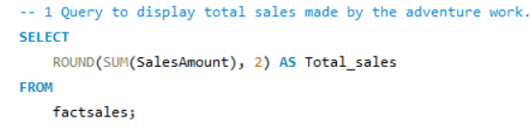




Calculate the total sales generated from cube bicycles.
Calculate the total profit generated from cube bicycles.

Slide 4

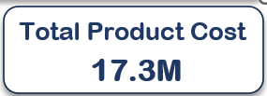

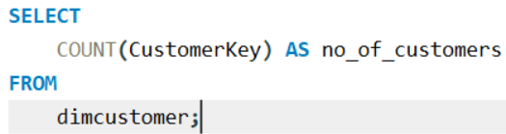


retrieve the total production cost from cube bicycles.
retrieve the customer’s count from cube bicycles.

Slide 5
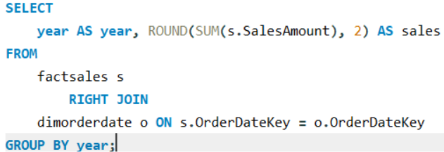
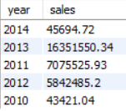
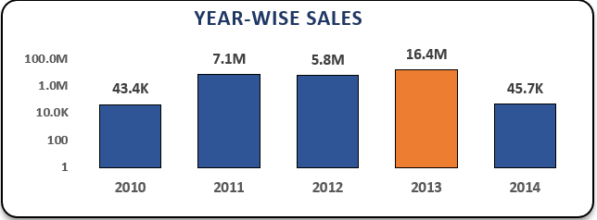
Calculate the year wise sales generated from cube bicycles

Slide 6
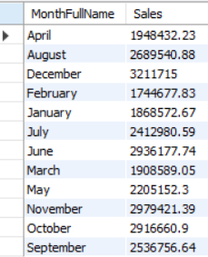
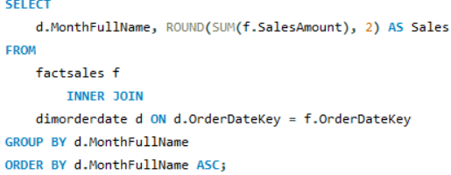
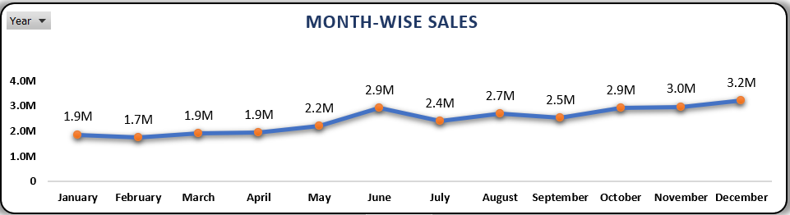
Calculate the month wise sales generated from cube bicycles

Slide 7
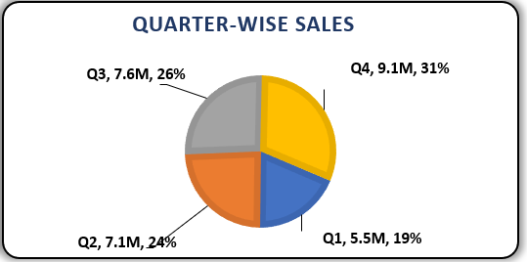
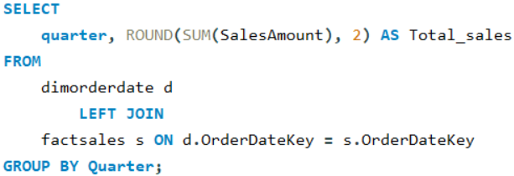
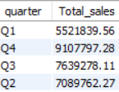
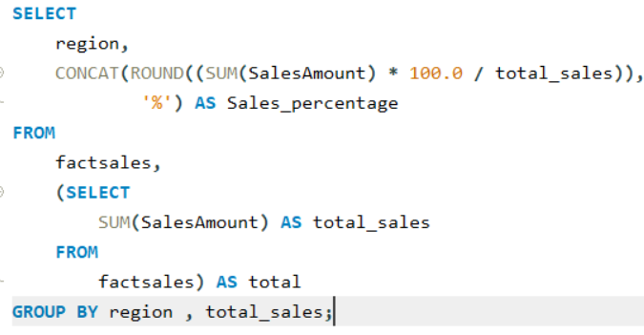
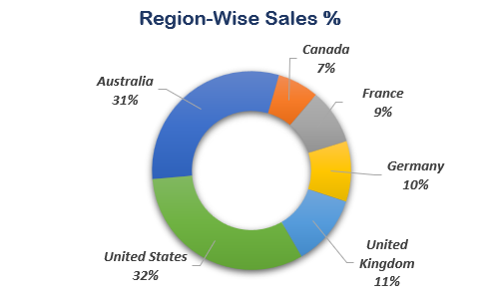
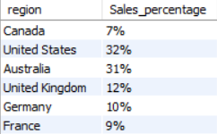
Calculate the quarter wise sales generated from cube bicycles
retrieve the Region-wise sales %

Slide 8
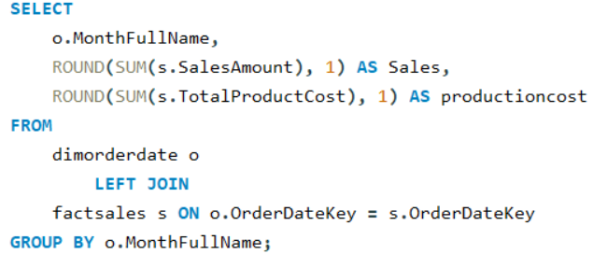
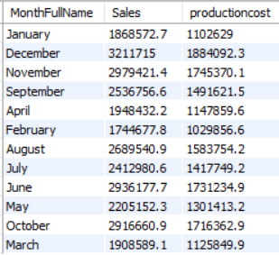
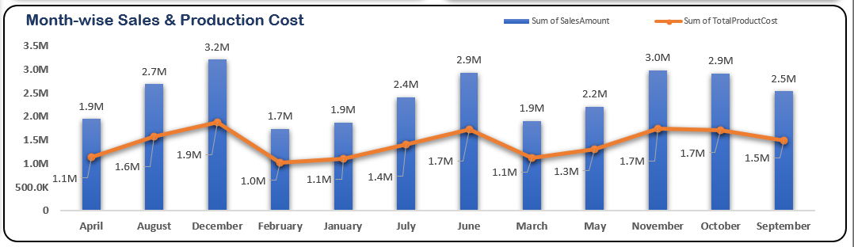
retrieve the month wise sales vs production cost

Slide 9
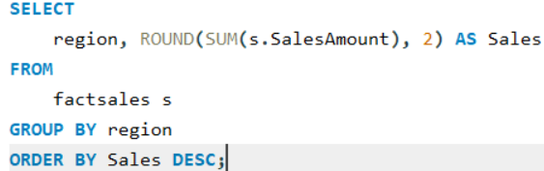
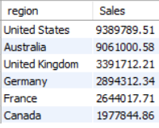
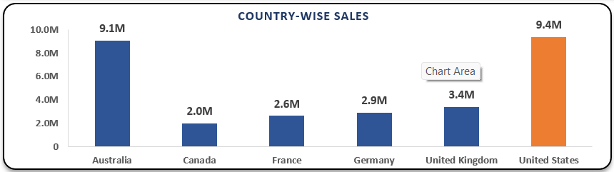
retrieve the country wise Sales generated from cube bicycles

Slide 10
Thank you !
Utkarsh Arya
Email: utk.arya1997@gmail.com
LinkedIn: linkedin.com/in/arya-utkarsh/

